Slide 1
BIOINFORMATICS
Phylogenetic Analysis
Federico M. Giorgi, PhD
Department of Pharmacy and Biotechnology

Slide 2
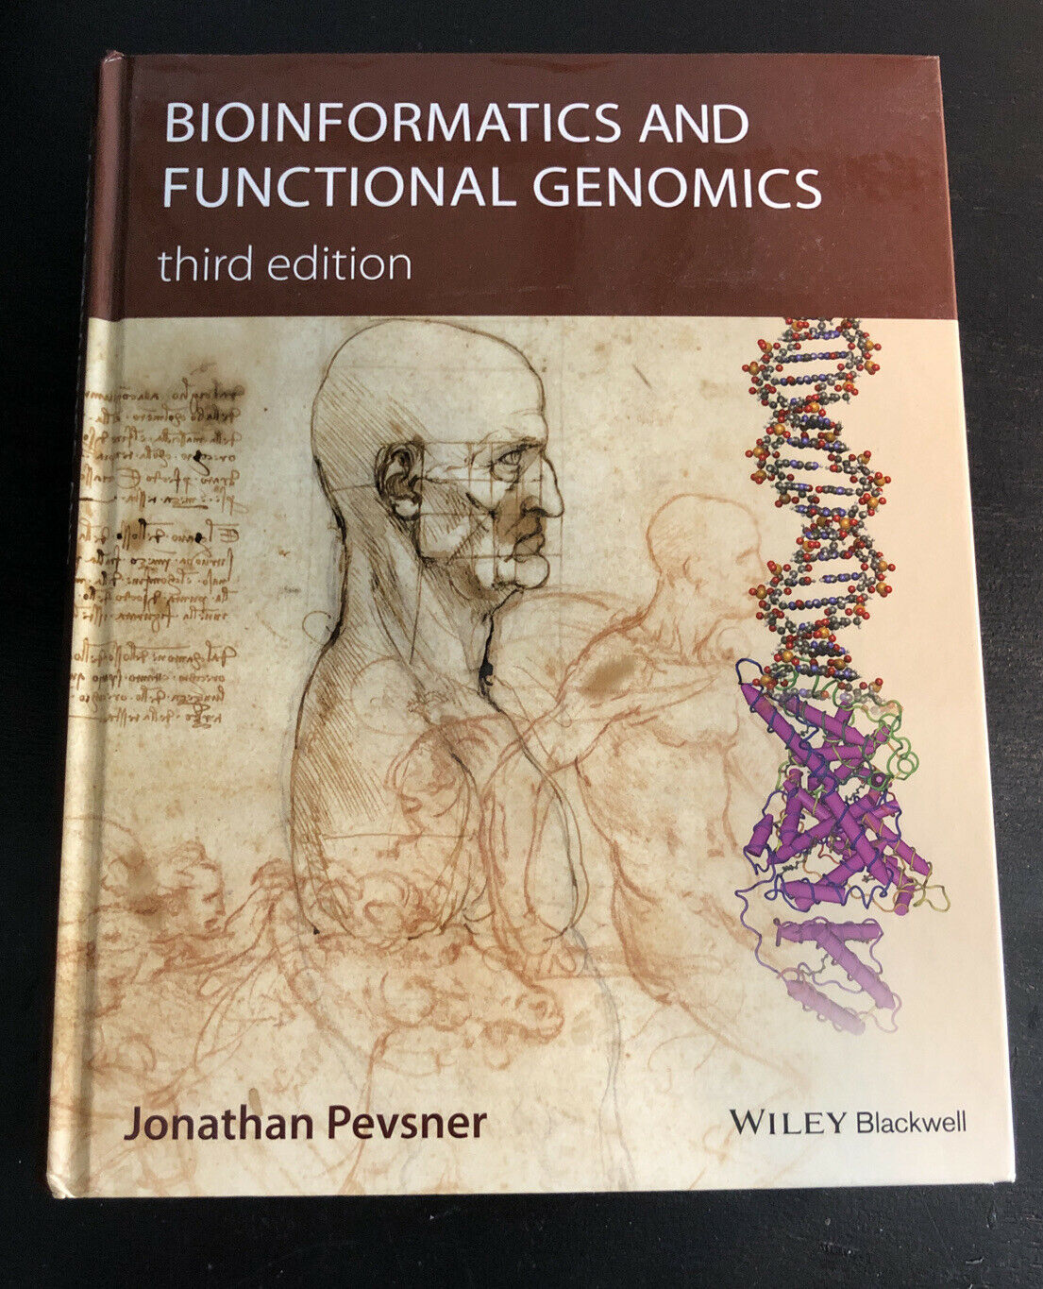
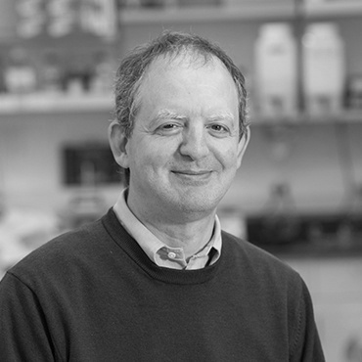
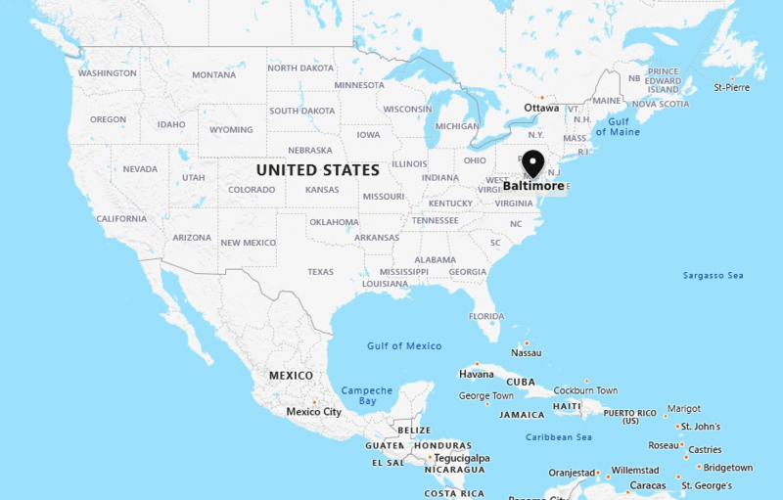

The Book of this Course
Bioinformatics and Functional Genomics – third edition
By Jonathan Pevsner
http://pevsnerlab.kennedykrieger.org/php/index.php

Slide 3
Chapter VII
Molecular Phylogeny and Evolution

Slide 4
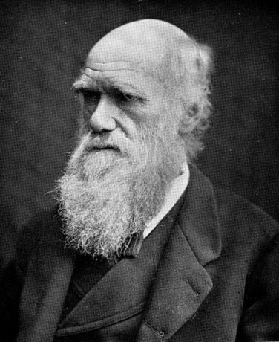
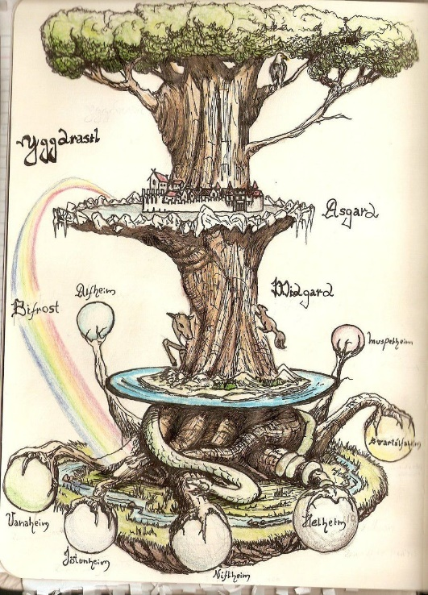
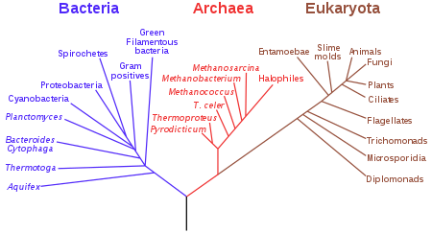

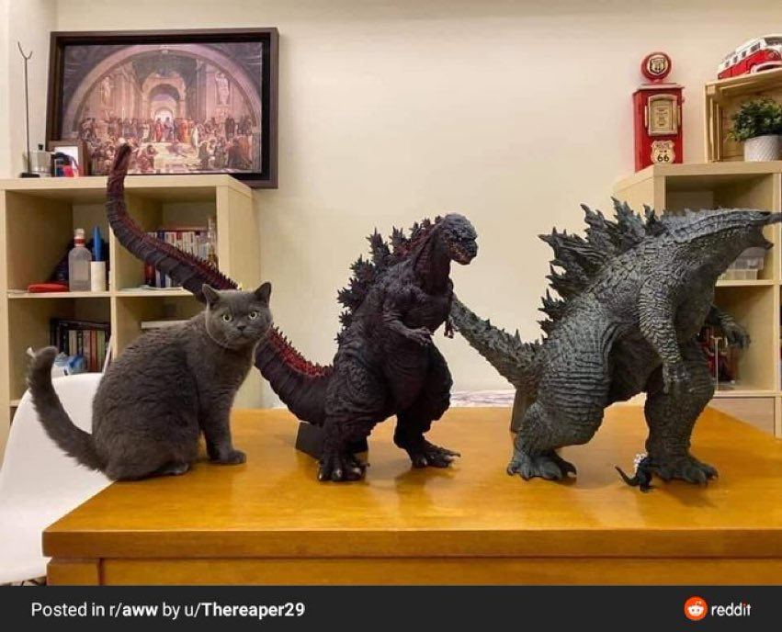
Phylogeny
The history of the evolution of a species or sequence
LUCA
Last Universal Common Ancestor

Slide 5
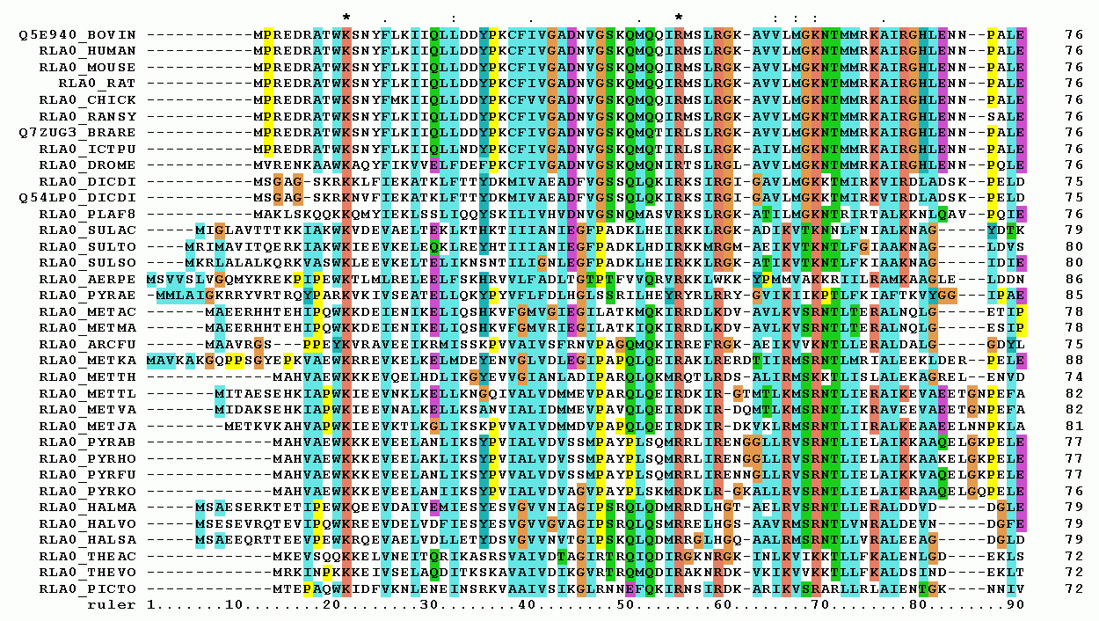
Phylogeny
The history of the evolution of a species or sequence

Slide 6
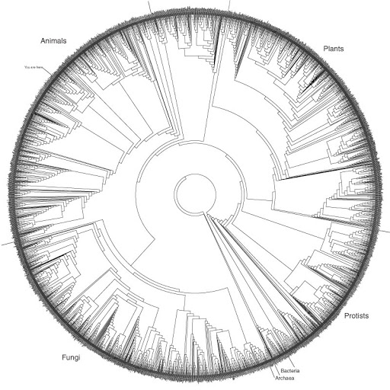
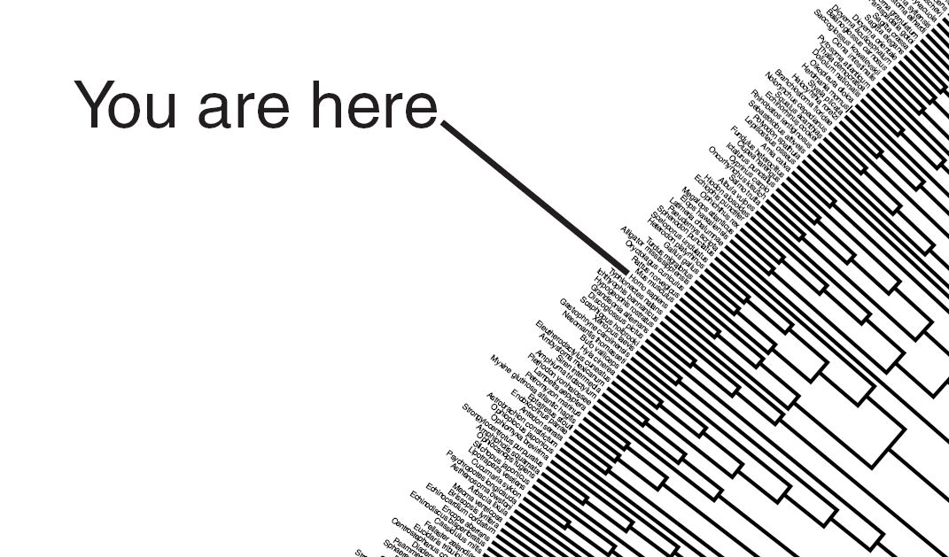
Phylogeny

Slide 7
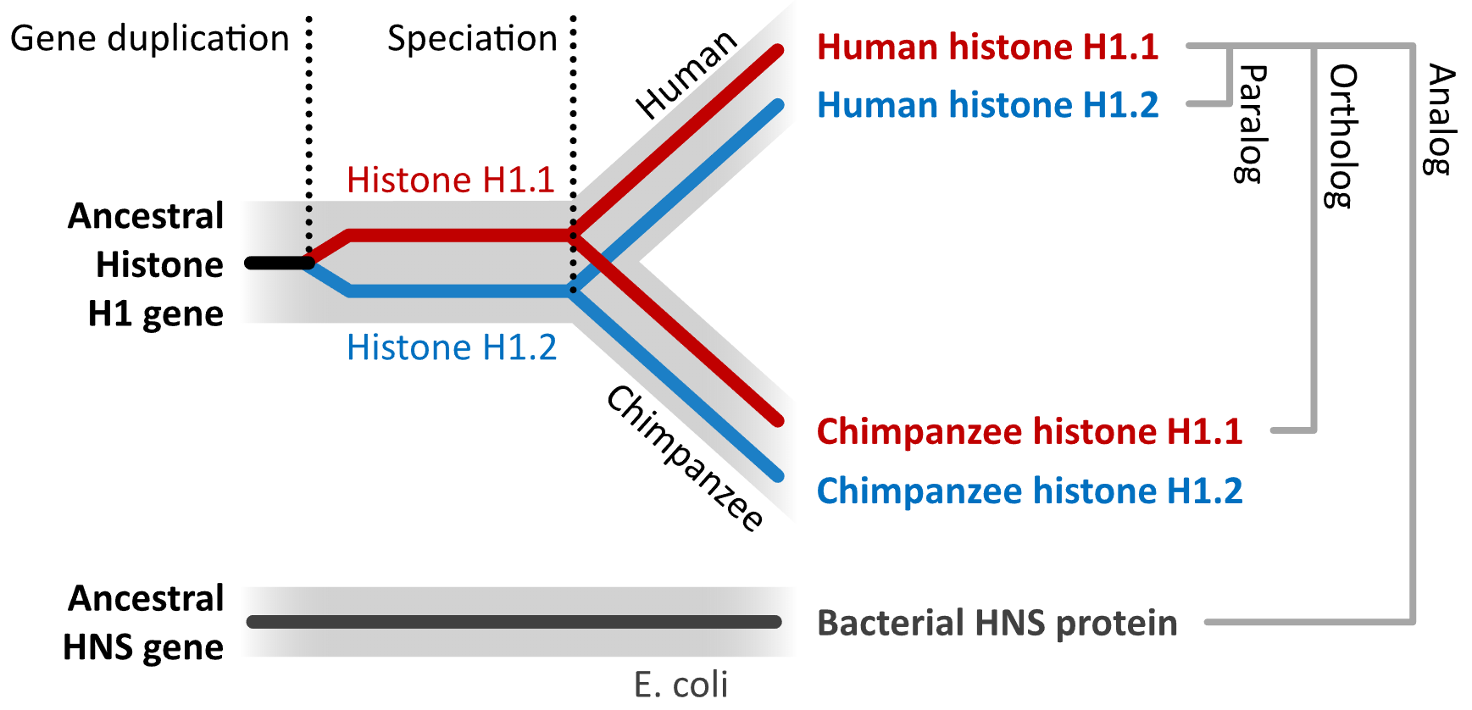
Nomenclature
Orthologs: sequences generated by a speciation event
Paralogs: sequences derived from a duplication event
Analogs: sequences with similar features but separate evolutionary origin
Homologs: general term for similar sequences, usually from a common ancestor
Inparalogs: paralogs within the same species (e.g. Human H1.1 and Human H1.2)
Outparalogs: paralogs in different species (e.g. Human H1.1 and Chimpanzee H1.2)

Slide 8
The Five Practical Stages of Phylogenetic Analysis
Sequence Acquisition
Multiple Sequence Alignment
Distance Calculation
statistical models to estimate the number of changes that occurred between multiple sequences (simplest is Hamming distance = nr. differences / sequence length)
Tree Building
Tree Evaluation

Slide 9



Structure of the Lesson
Sequence Acquisition
Phylogenesis with MEGA
Multiple Sequence Analysis
Distance Calculation
Tree Building
Tree Evaluation
(Optional) Beautify the tree with InkScape
Alternative command-line tools
PHYLIP
ETE

Slide 10
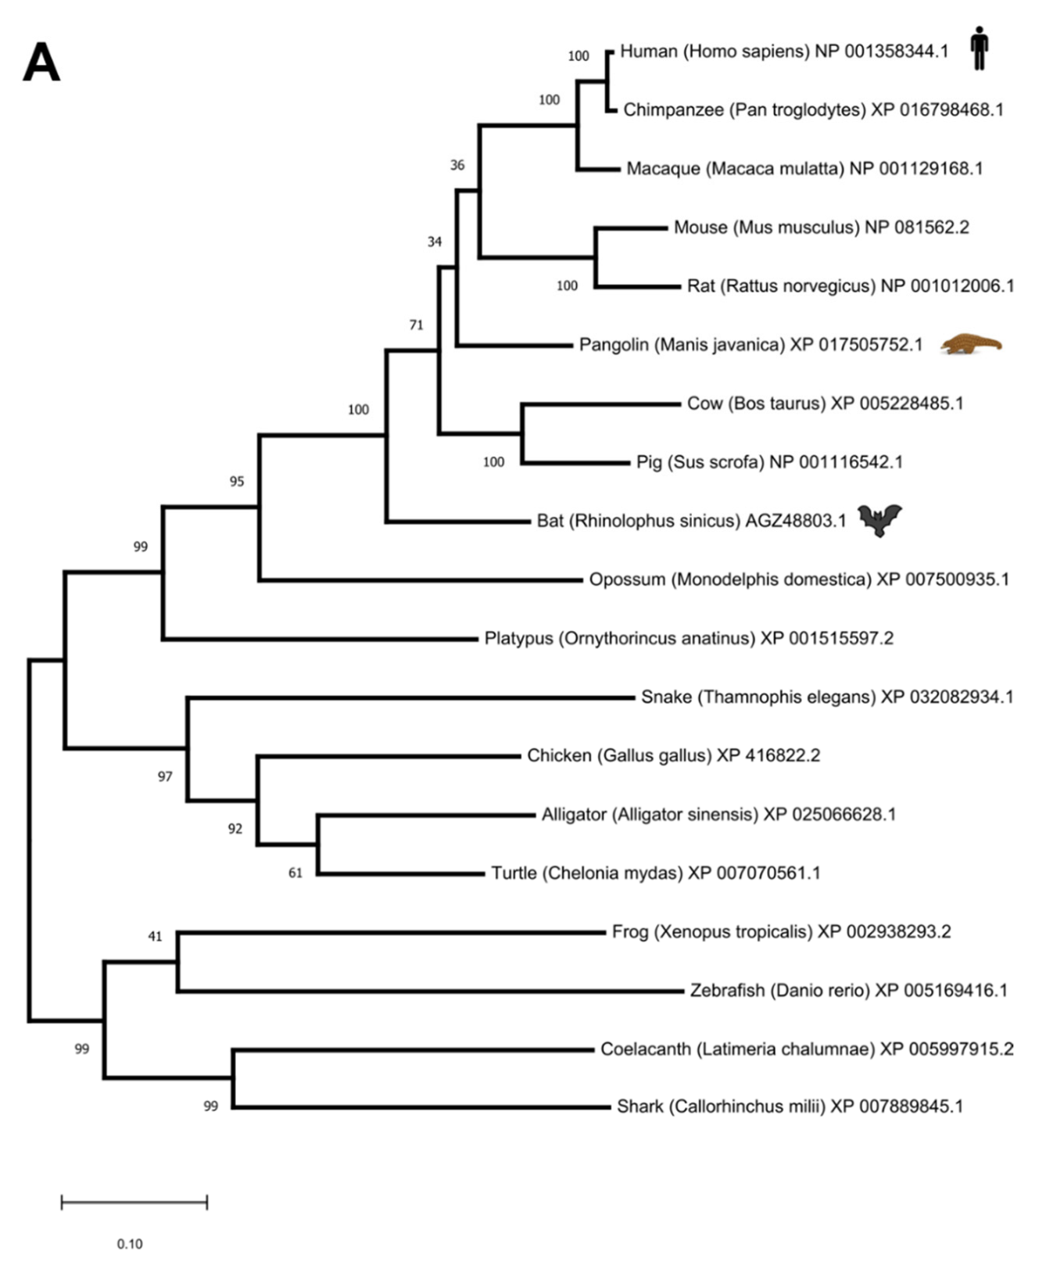
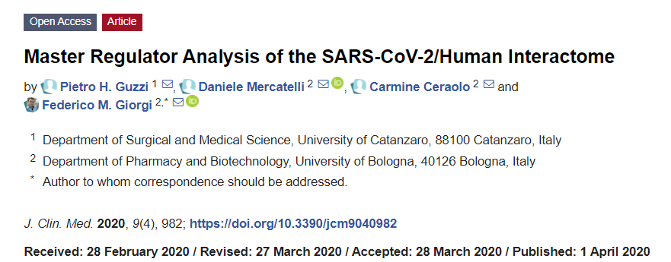
Example
Phylogenetic tree for ACE2
Angiotensin-converting Enzyme 2
Which organisms?
It depends on how "recent" the protein is
Usually, one species per group, more dense towards human
Always report the sequence id (here, NCBI)
The ruler indicates the distance
The number on branches is the bootstrap value (max=100)
Adding icons is a personal touch

Slide 11
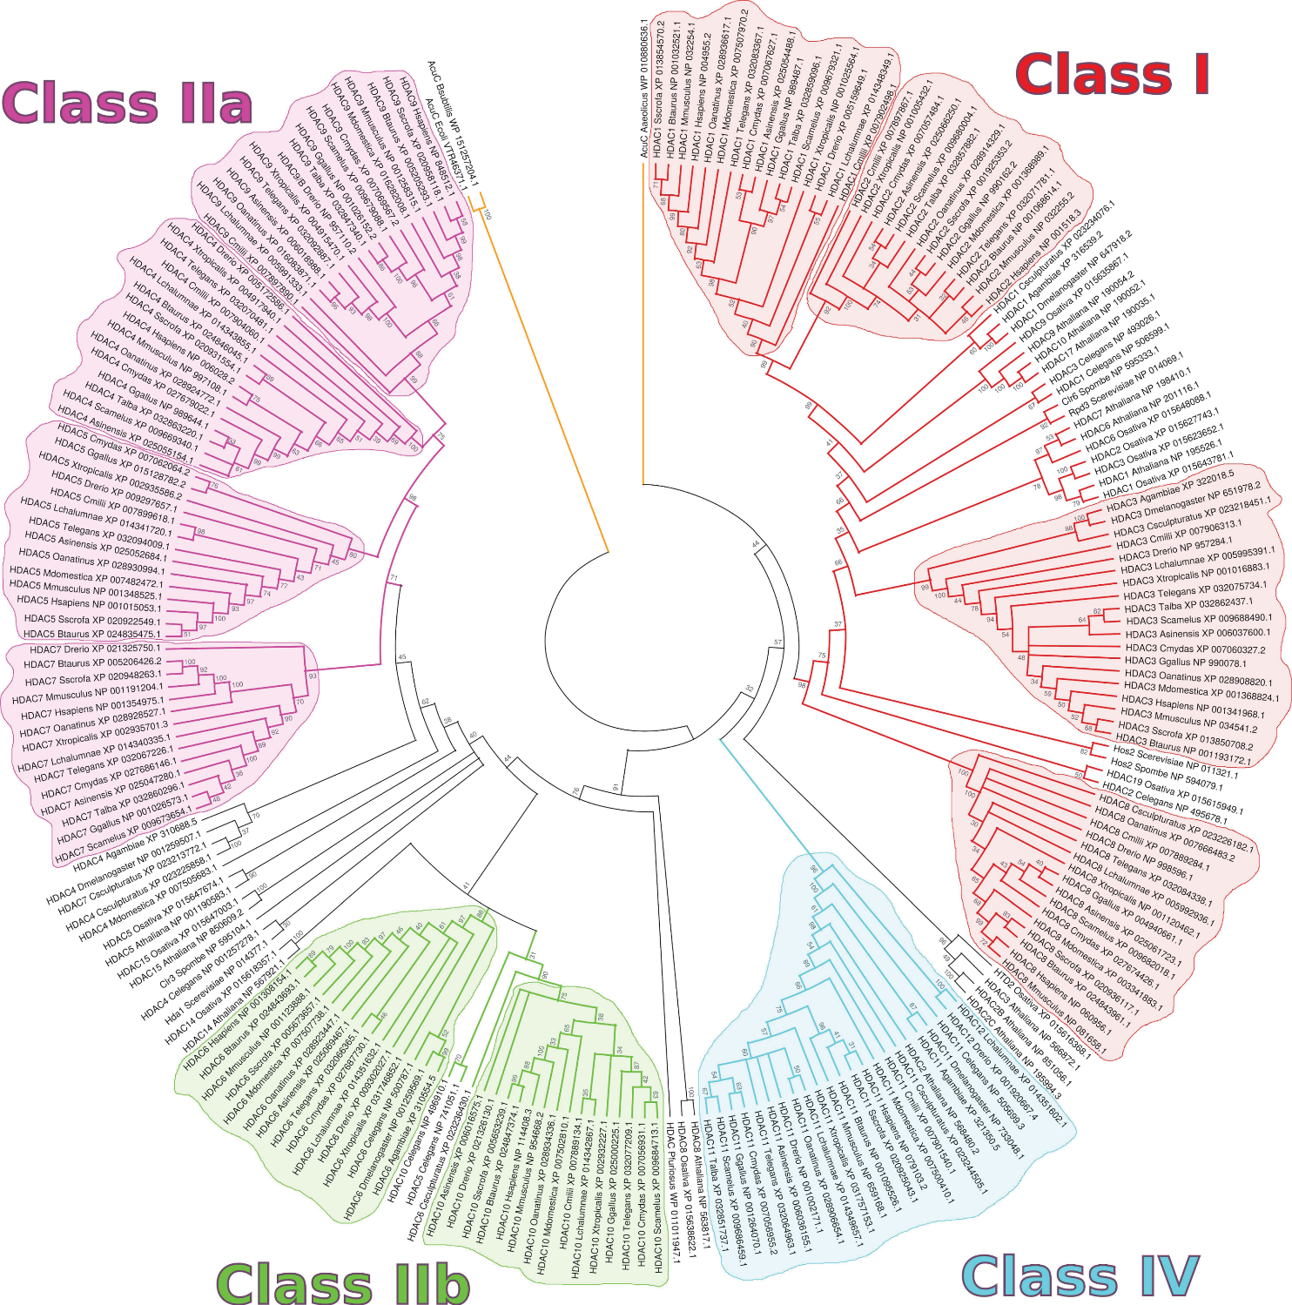
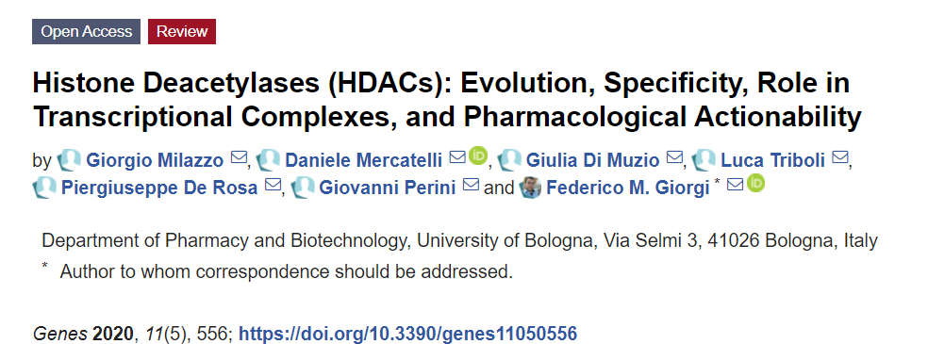
Another Example

Slide 12
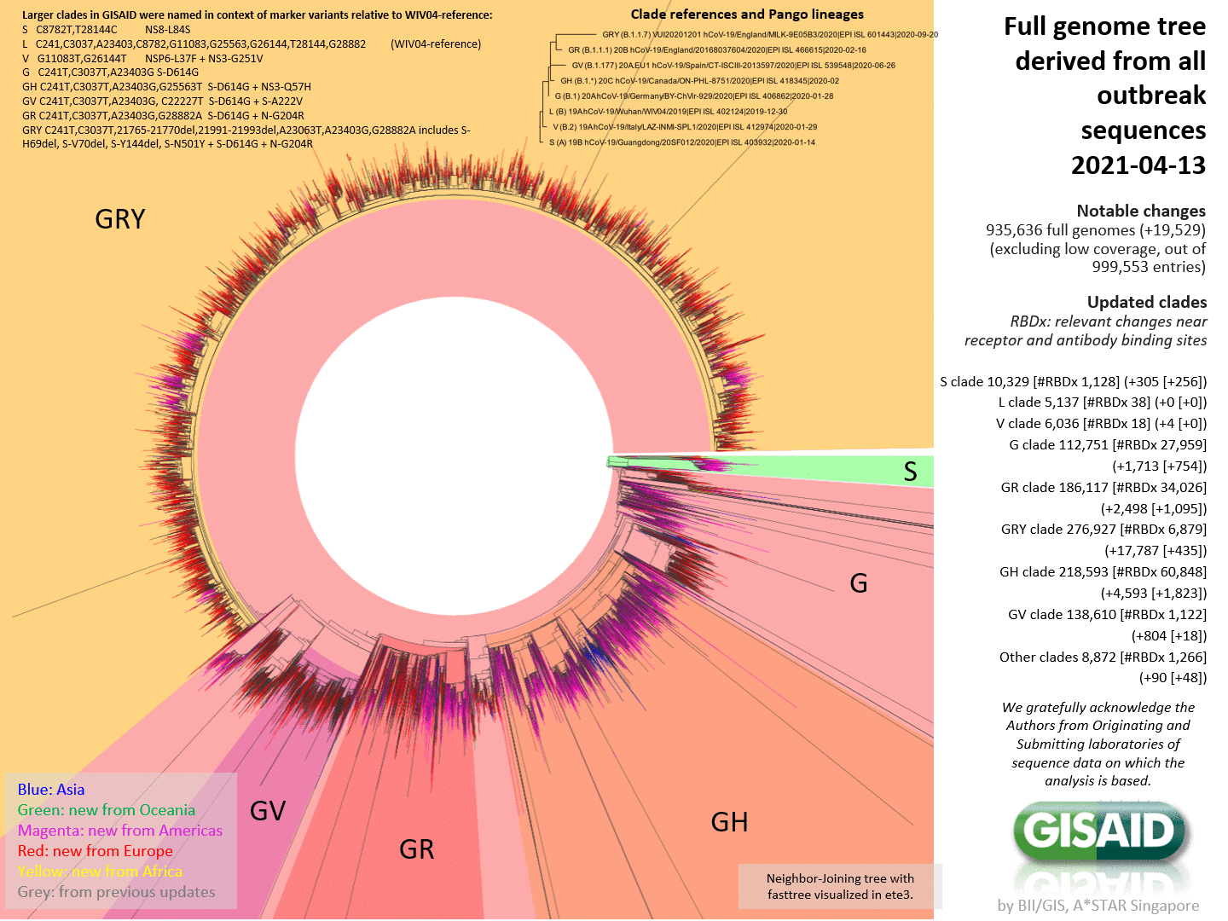
Phylogenetic trees can be HUGE
Nearly 1 million sequences here

Slide 13
1. Sequence Acquisition

Slide 14

Sequence acquisition
Let's find all orthologs across species of:
SLC25A12 (also known as AGC1 or Aralar 1, gene involved in a rare childhood hypomyelination)
Let's go to NCBI protein to get the representative for Homo sapiens
https://www.ncbi.nlm.nih.gov/protein/
Query: SLC25A12 AND "Homo sapiens"[orgn]
When possible, select "RefSeq"
Better NP_ , followed by XP_ entries
If multiple RefSeq isoforms are present, usually the longest one is chosen
For human, a good representative for SLC25A12 is NP_003696.2
Click on "FASTA" and copy/paste the sequence in a new file agc1.fasta
Big problem are synonyms: e.g. SLC25A12 is called "Aralar 1" in NCBI...
This is a key step making phylogenetic analysis hard sometimes

Slide 15
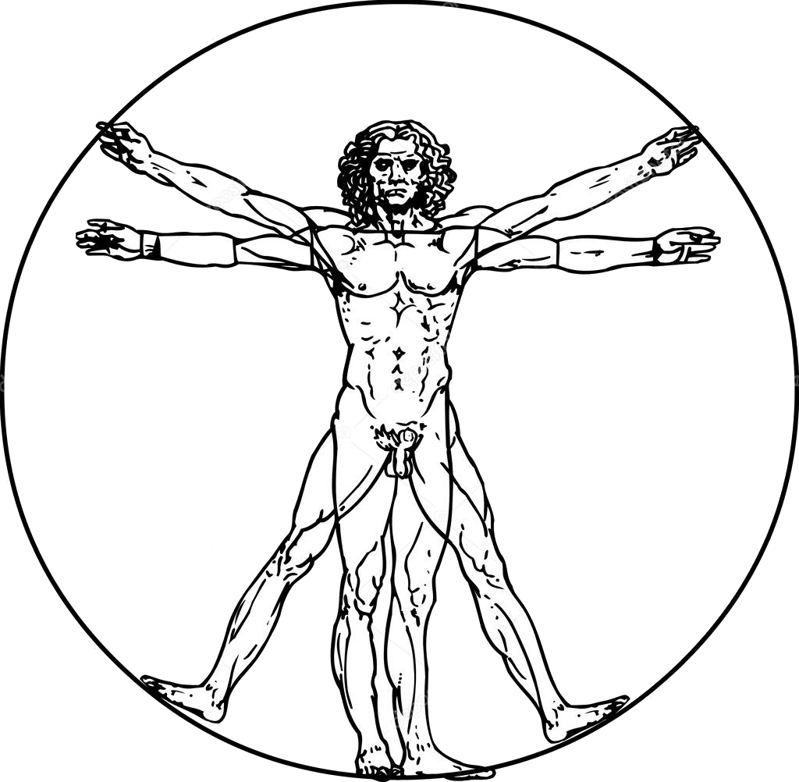


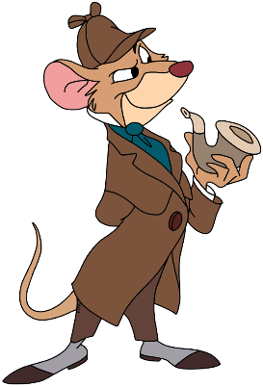

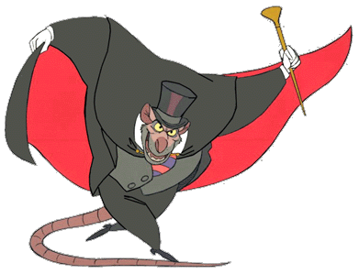
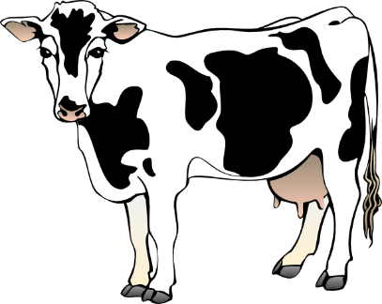
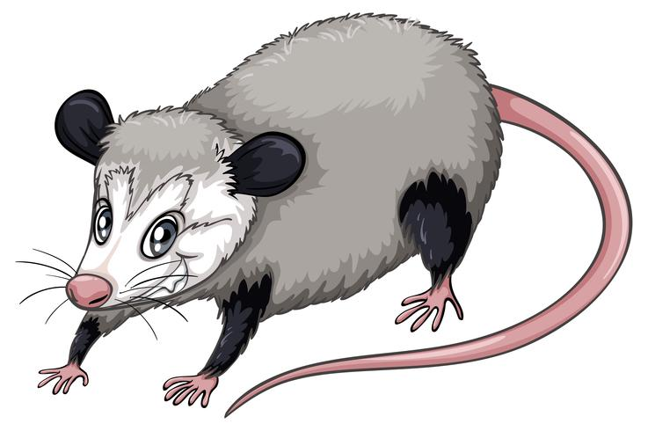

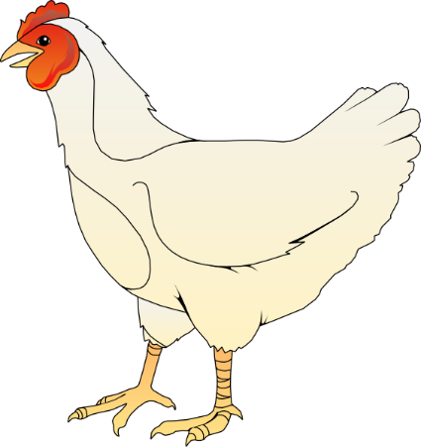

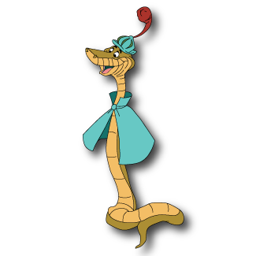

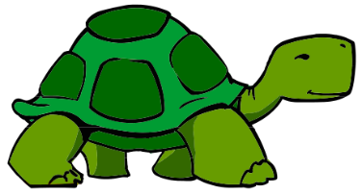
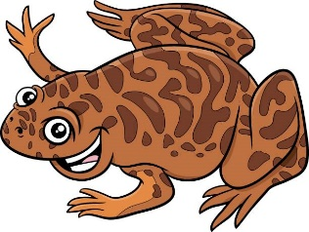
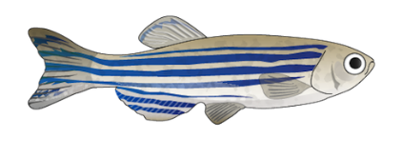
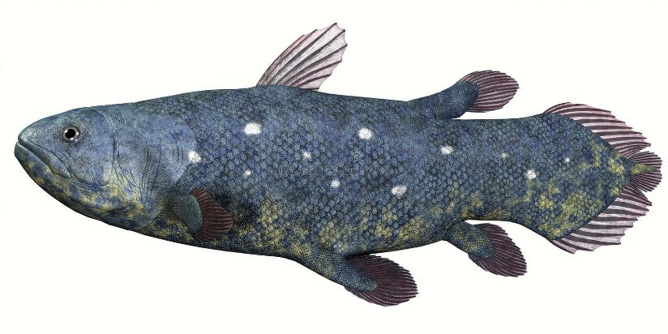


Exercise on Sequence Acquisition
Prepare a multiFASTA with SLC25A12 (Aralar1, AGC1) from these organisms:
Homo sapiens
Pan troglodytes (Chimpanzee)
Macaca mulatta (Macaque)
Mus musculus (Mouse)
Rattus norvegicus (Rat)
Bos taurus (Cow)
Sus scrofa (Pig)
Desmodus rotundus (Bat)
Monodelphis domestica (Opossum)
Ornithorhynchus anatinus (Platypus)
Gallus gallus (Chicken)
Thamnophis elegans (Snake)
Alligator sinensis (Alligator)
Chelonia mydas (Turtle)
Xenopus tropicalis (Frog)
Danio rerio (Zebrafish)
Latimeria chalumnae (Coealacanth)
Scyliorhinus canicula (Shark)
Drosophila melanogaster (Fruit fly)

Slide 16
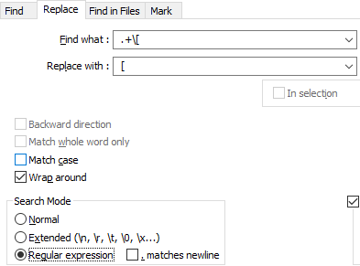
Exercise (continued)
Since all these sequences have the same title, you can shorten it for visualization purposes
Using grep, sed, or a text editor
I used Notepad++
Find “ .+[“
E.g.
> NP_766024.1 calcium-binding mitochondrial carrier protein Aralar1 [Mus musculus]
> NP_766024.1 [Mus musculus]
For some organisms, e.g., Drosophila melanogaster, there is no automated entry. Use BLAST (human protein vs. Drosophila sequences) to find the SLC25A12 ortholog
An automated (and incomplete) list of orthologs is here: https://www.ncbi.nlm.nih.gov/gene/8604/ortholog/?scope=7776&term=SLC25A12
Panicking? Click on the coelacanth in the previous slide

Slide 17
MEGA Software Molecular Evolutionary Genetics Analysis

Slide 18
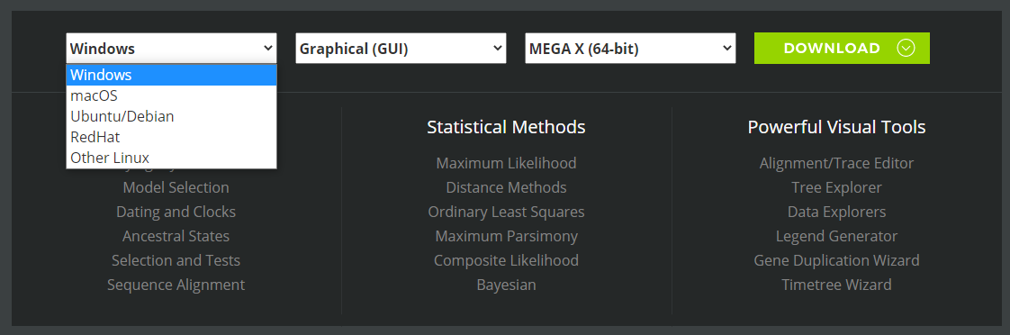
Download and install MEGA
Free Software
Install it on your PC (all systems are supported)
Link: https://www.megasoftware.net/

Slide 19
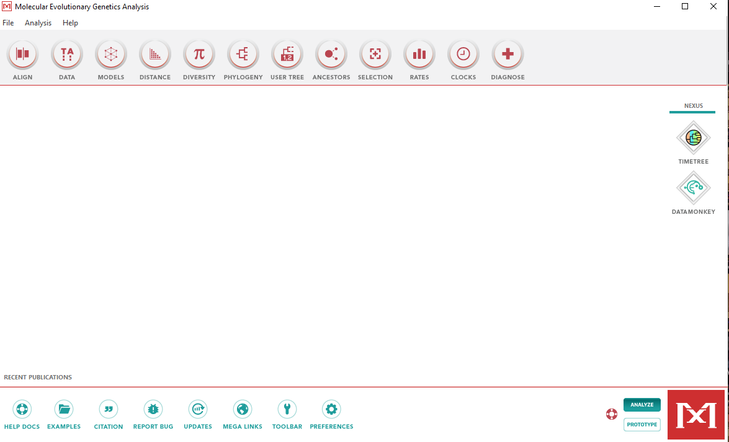
Starting MEGA

Slide 20
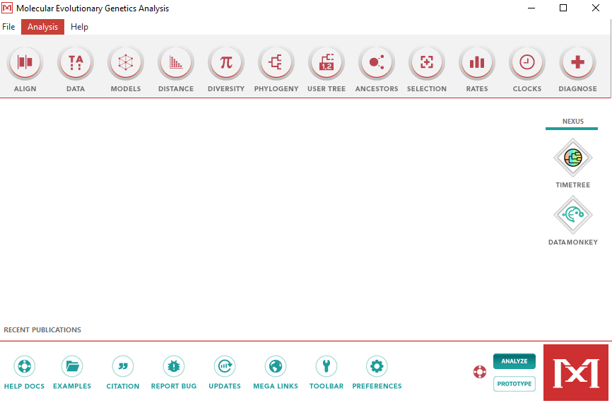
Loading sequences on MEGA
Click on "Align"
Edit/Build Alignment
Retrieve a sequence from a file

Slide 21
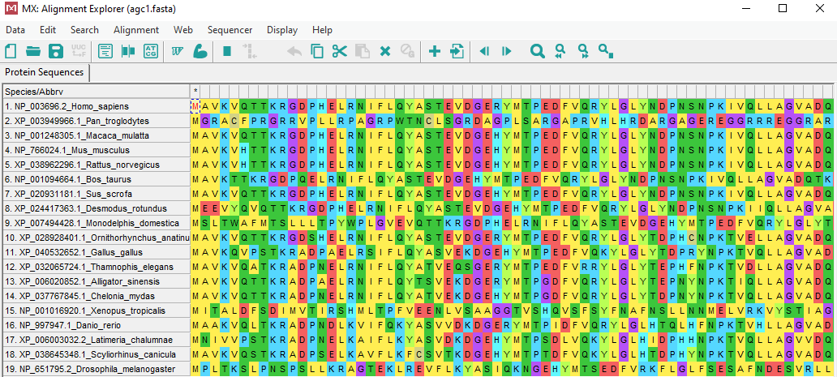
All sequences visualized here
What do the colors mean?

Slide 22
2. Multiple Sequence Alignment

Slide 23
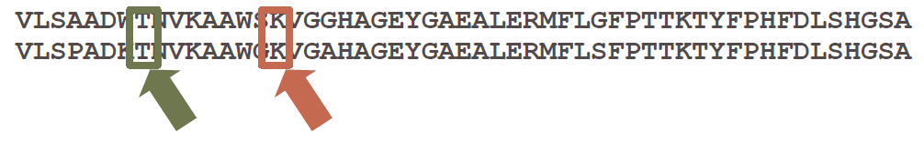
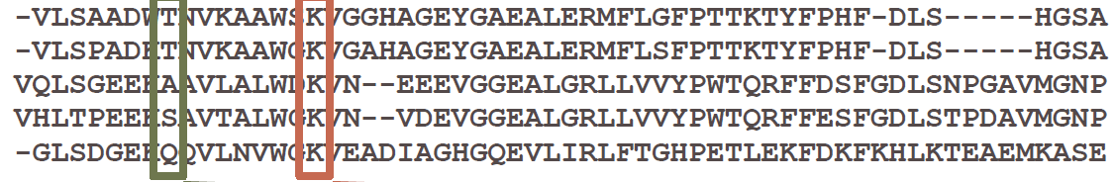
Multiple Sequence Alignment (MSA)
What's the most important aminoacid?
In many cases, conserved aminoacids have a specific, important role in the function of the protein/cell/organism
The more sequences you have, the more precise the identification of key sequence portions

Slide 24
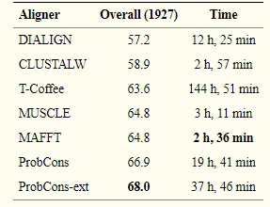
MSA Algorithms
They can all be run also on the LINUX command line:
ClustalW (1994): historically, the first widely used MSA algorithm. It is slower and less accurate than muscle. Implemented by the command clustalw
T-Coffee (2000): a faster and more accurate improvement of ClustalW. Implemented by the command t_coffee
MUSCLE (2004): the Lamborghini of MSA tools. Very fast, very accurate. muscle
ProbCons (2005): accuracy improvement at the expense of speed. probcons
Kalign (2005): it should be a tool optimized for many sequences (large scale MSAs of more than 10,000), but in reality, it is slower than MUSCLE. However, it can be multi-threaded. kalign
Clustal Omega (2011): the newest kid in the block. It is designed for very large numbers of sequences (>10,000) and it uses very efficient code and precomputed multialignments from protein databases (e.g. Pfam). clustalo
Accuracy benchmark

Slide 25
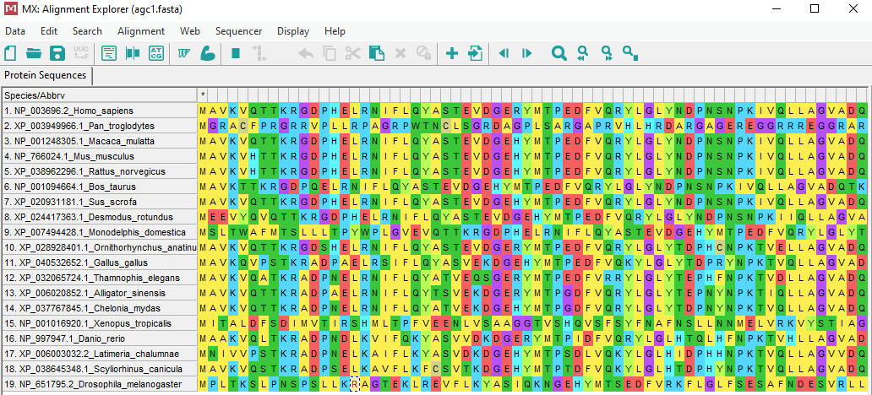
MSA on MEGA
Click on the flexing Muscle
Click OK OK OK, keep clicking
Keep default MUSCLE parameters

Slide 26
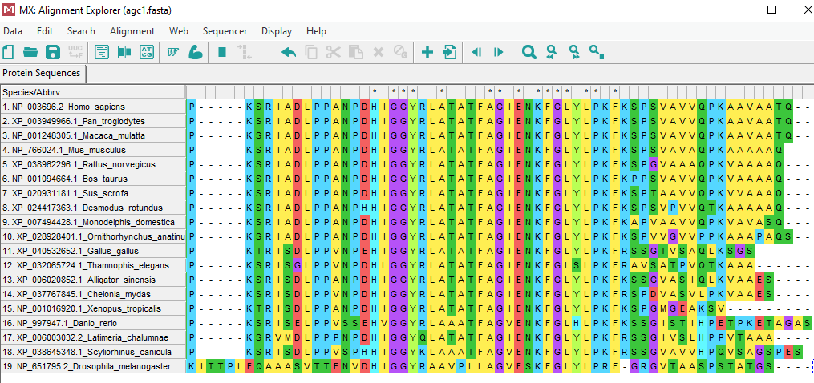
MSA achieved!

Slide 27
3. Distance Calculation
4. Tree Building

Slide 28
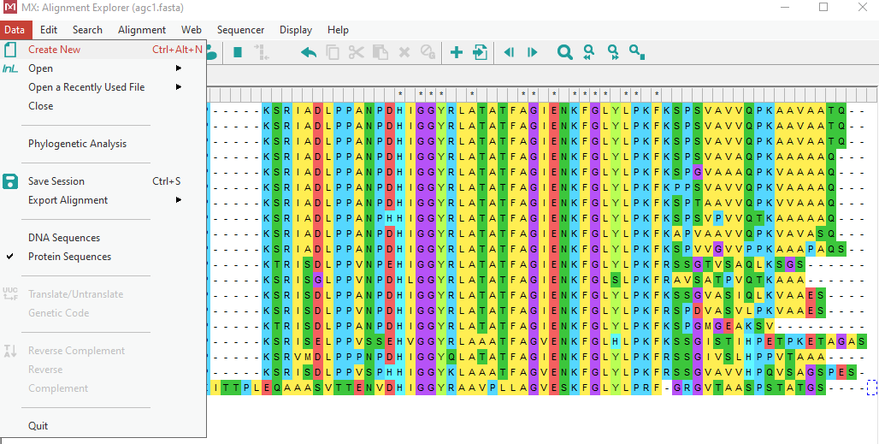
MEGA for Tree Building
Both Distance Calculation and Tree Building are done in the same step
"Phylogenetic Analysis" in MEGA
Proceeding from here is a bit hidden... But you are here to learn the secret

Slide 29
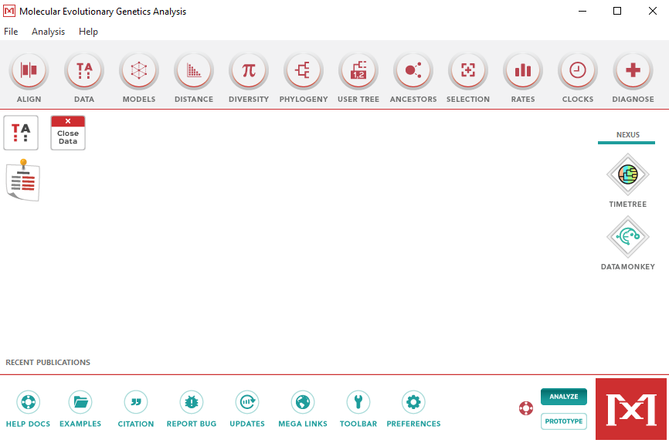
MEGA for Tree Building
And then let's move to the "Phylogeny" part of MEGA

Slide 30
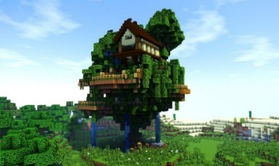
Tree Building
Some Major Algorithms:
Neighbor-Joining: make a tree where the branch lengths correspond as closely as possible to the pairwise distances (fast, good for many long sequences)
Maximum Likelihood: determine a tree topology that has the highest likelihood of producing the observed dataset (slow but more accurate)
Minimum Evolution/Maximum Parsimony: determine a tree with the shortest possible branch length
UPGMA: Unweighted-Pair Group Method with Arithmetic mean
Many less efficient, accurate and/or popular algorithms exist, but MEGA doesn't implement them:
Bayesian methods

Slide 31
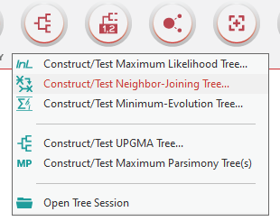
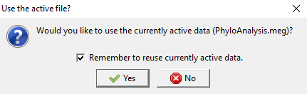

Building a Neighbor Joining Tree
Click "yes"
Keep all defaults
Click OK OK OK
Enjoy the progress bar
This is step 3 (i.e. how distance between sequences is determined). The simplest is "nr. of different amino acids" but you can leave the default

Slide 32
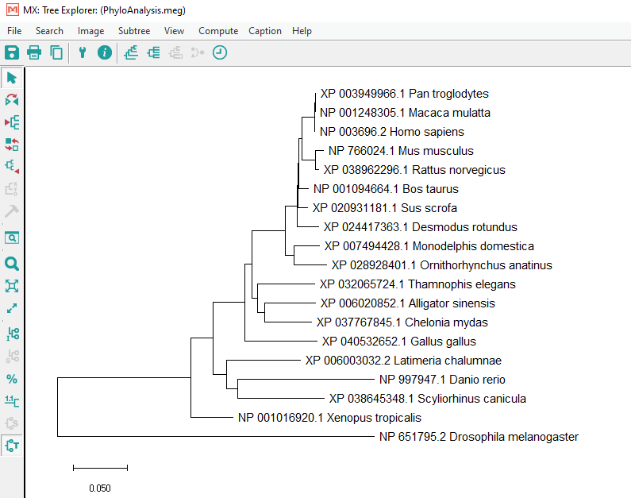
Well done!
The tree comes with a prepared figure caption for your paper:
Evolutionary relationships of taxa
The evolutionary history was inferred using the Neighbor-Joining method [1]. The optimal tree with the sum of branch length = 1.21886175 is shown. The tree is drawn to scale, with branch lengths in the same units as those of the evolutionary distances used to infer the phylogenetic tree. The evolutionary distances were computed using the Poisson correction method [2] and are in the units of the number of amino acid substitutions per site. This analysis involved 19 amino acid sequences. All ambiguous positions were removed for each sequence pair (pairwise deletion option). There were a total of 789 positions in the final dataset. Evolutionary analyses were conducted in MEGA X [3].
1. Saitou N. and Nei M. (1987). The neighbor-joining method: A new method for reconstructing phylogenetic trees. Molecular Biology and Evolution 4:406-425.
2. Zuckerkandl E. and Pauling L. (1965). Evolutionary divergence and convergence in proteins. Edited in Evolving Genes and Proteins by V. Bryson and H.J. Vogel, pp. 97-166. Academic Press, New York.
3. Kumar S., Stecher G., Li M., Knyaz C., and Tamura K. (2018). MEGA X: Molecular Evolutionary Genetics Analysis across computing platforms. Molecular Biology and Evolution 35:1547-1549.

Slide 33
5. Tree Evaluation

Slide 34
Tree Evaluation
Technically, also a visual inspection by a scientist counts as a "tree evaluation"
However, better tests were developed, e.g. resampling methods:
Will portions of the same MSA yield similar trees?

Slide 35
Resampling methods
Bootstrapping: portions of MSA are substituted with other portions of the same MSA
MSA length in each test is conserved
Jacknifing: portions of MSA are removed
MSA length in each test is reduced

Slide 36
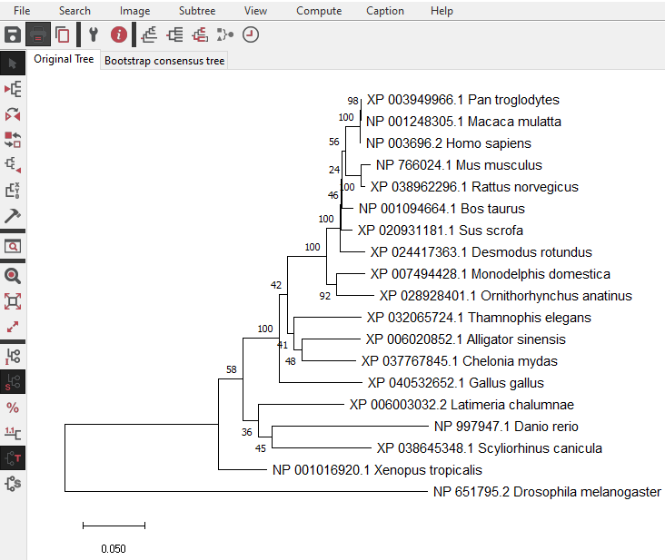
Results!
AGC1 tree

Slide 37
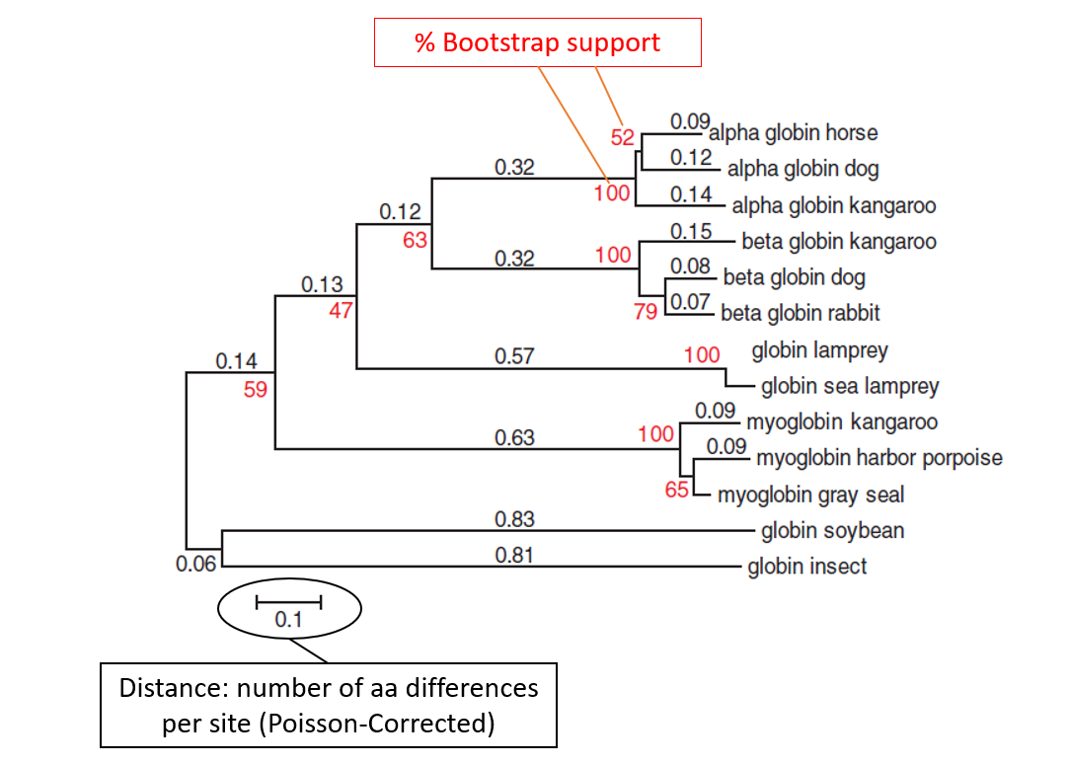
Bootsrapped tree
Bootstrapping test will add robustness to each branching point of the tree

Slide 38
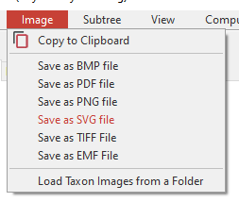



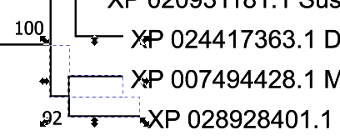
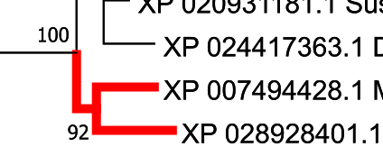

Beautify the Tree
Export the tree as an SVG file
Edit the SVG file with another free tool, Inkscape
https://inkscape.org/
Right-click on the tree, ungroup
This button lets you edit the text:
You can select specific branches with the select button:
Click on some branches, then Object-->"Fill and Stroke" to change their thickness and color

Slide 39
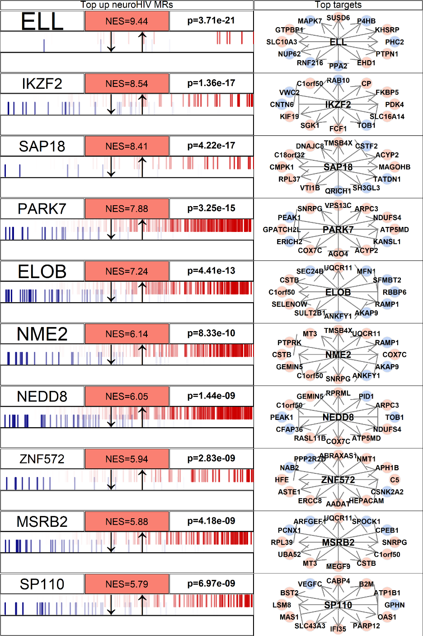
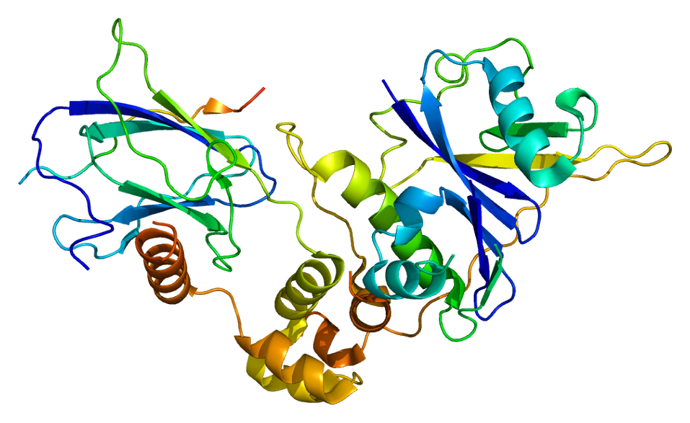
Protein in need of a phylogenetic tree
ELOB: upregulated in cells during SARS-CoV-2 infection
Elongin B: helps the RNA Polymerase II in not stalling during transcription
Check it on GeneCards

Slide 40
The ELOB hypothesis
ELOB
RNA methylation
ELOB protein
Ribosome
ELOB mRNA
Normal Cell
SARS-CoV-2-infected Cell
ELOB
ELOB
ELOB
ELOB
ELOB
ELOB
ELOB
ELOB
AAAAA
AAAAA
RNA Methylator
RNA Methylator

Slide 41
Exercise
Retrieve ELOB sequences for the same organisms we used for SLC25A12
Also Pangolin (Manis javanica)
Generate a Maximum Likelihood tree with the ELOB sequences
Perform a bootstrap test with 100 bootstraps
Try flipping subtrees
Compare "Original Tree" and "Bootstrap consensus tree"
With Inkscape, highlight Pangolin and Bat branches and sequence names in red
From Inkscape, file-->export PNG image
Send me your PNG tree to federico.giorgi@unibo.it
Not mandatory, no score will be given!
I am just curious

Slide 42
Federico M. Giorgi, PhD
Department of Pharmacy and Biotechnology
federico.giorgi@unibo.it

Slide 43
Hard truths
I'm not sure whose twisted idea it was

Slide 44
Hard truths
I'm not sure whose twisted idea it was
to put hundreds of young people in underfunded universities

Slide 45
Hard truths
I'm not sure whose twisted idea it was
to put hundreds of young people in underfunded universities
run by people whose dreams were crushed years ago

Slide 46
Hard truths
I'm not sure whose twisted idea it was
to put hundreds of young people in underfunded universities
run by people whose dreams were crushed years ago
...but I admire the sadism.
Wednesday Addams

Slide 47


